Slide 1
Structures in C++
Rishikesh Paudel
(Class 4)

Slide 2
What have we learnt so far?
Day 0
Installing and Using C/C++ compiler
Make programs, compile and execute C/C++ programs using VS Code IDE
Format of C/C++ Program
Comments in C/C++
Taking Input and Providing Output
Variable, Data types and how much memory they occupy
Rules for variable declaration

Slide 3
What have we learnt so far?
Day 1
Tokens (Operators, Identifiers, Keywords, Constants, String, Special Symbols)
Arrays and Pointers (Pointers will be discussed again!)

Slide 4
What have we learnt so far?
Day 2
If statement
If … else statement
Conditional statement ( ?: )
If … else if … else statement
Switch statement
While statement
Do … while statement
For statement
Nested if, while, for statements

Slide 5
What have we learnt so far?
Day 3
All about arrays
Strings: an array of characters

Slide 6

Objectives
Structures Definition
How to create a structure?
How to declare a structure for using it?
How is structure stored in memory?
How does the memory look like?
Use case of structure
Array of structure
Structure of arrays
Structure within structures

Slide 7
What are Structures?
Structures (also called structs) are a way to group several related variables into one place for easier handling and identification.
Each variable in the structure is known as a member of the structure.

Slide 8
How to create a Structure?
struct Student
{
char name[50];
int roll;
char sec;
float marks;
};

Slide 9
How to declare a structure for using it?
struct student s1, s2, s3;

Slide 10
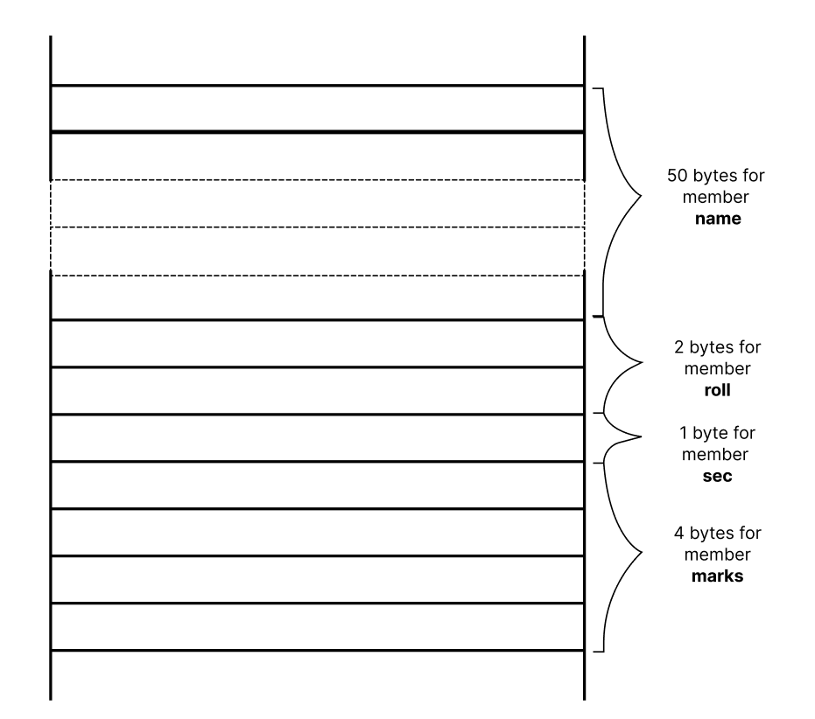
For s1
50 bytes of name
2 bytes for roll
1 byte for sec
4 bytes for marks
Total: 57 bytes

Slide 11
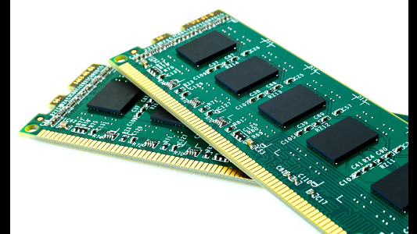

Slide 12
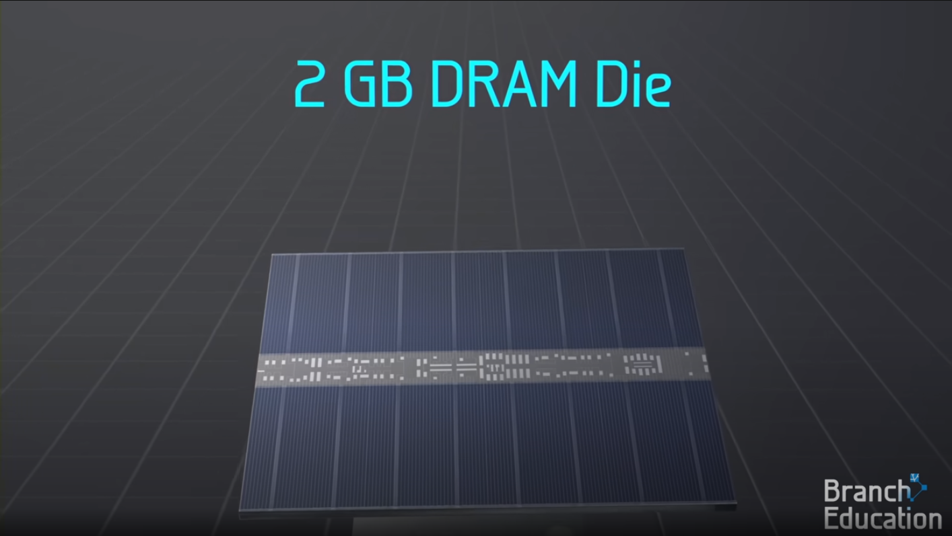

Slide 13
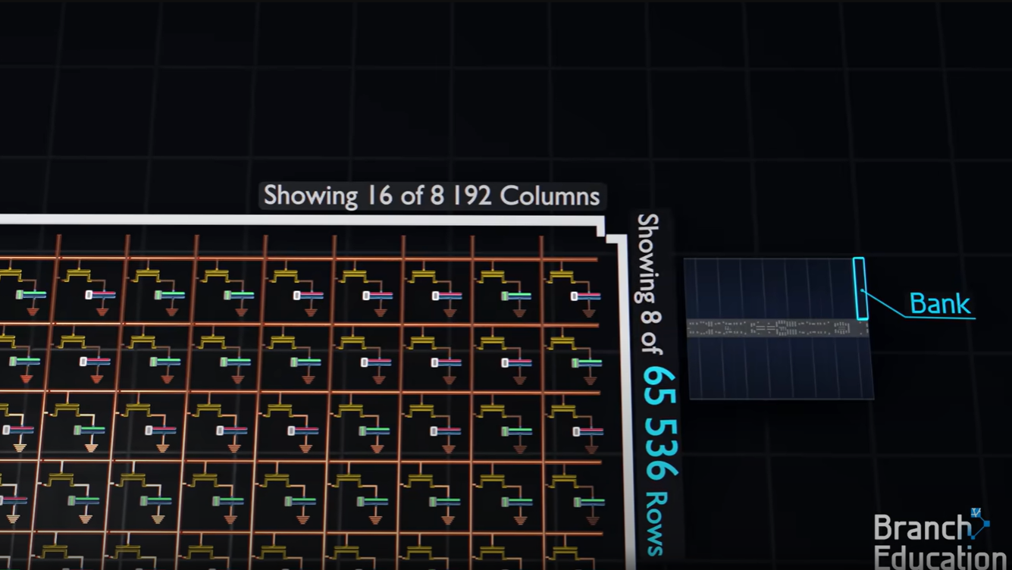

Slide 14

Illustrating the use of structure

Slide 15

Arrays of structures:

Slide 16
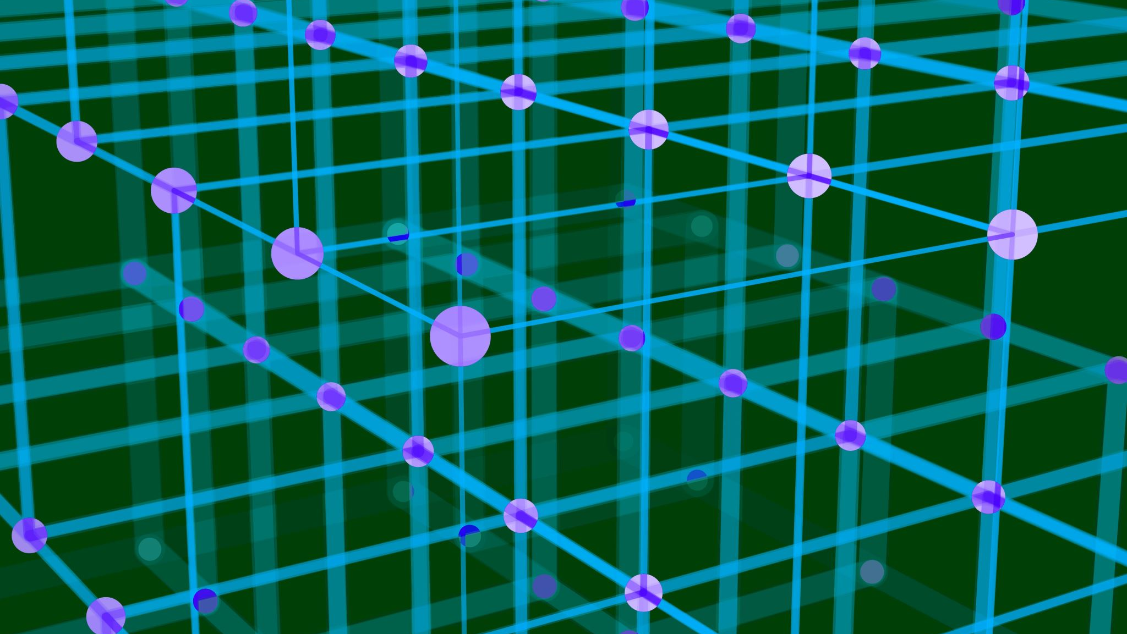
Structure of Arrays

Slide 17

Structure within Structures

Slide 18

Useful to know:
The ”.” is also known as member operator

